Slide 1
Project Summary April 16, 2020

Slide 2
Background
Dataset used: 2016-Brand 1 & 2
After understanding information about each feature, I decided to use “bin”, “retry indicator” (# of retry) to model the respond variable “Approval%”.
So, most of my models I built are in the form:
Approval% ~ bin + retry_indicator
All in all, we want to classify Approval with bin + retry

Slide 3
Data visualization
1

Slide 4
Data visualization
Since we want to model 3 features, we can plot a 3-D graph with x-axis as “bin”, y-axis as “retry”, and z-axis as “Approval%”
In addition, we need to plot the density of where Approval% is most likely to be 1.

Slide 5
Here is the 3-D Plot

Slide 6
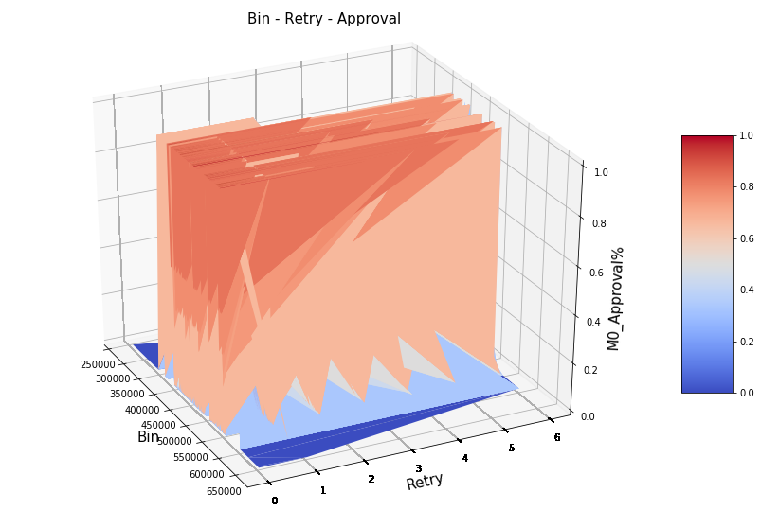
Note: the “more red” parts of the graph Approval = 1 is more dense. ----------------------- The “more blue” parts of the graph Approval = 0 is more likely occur.

Slide 7
BIG CONCEPT

Slide 8
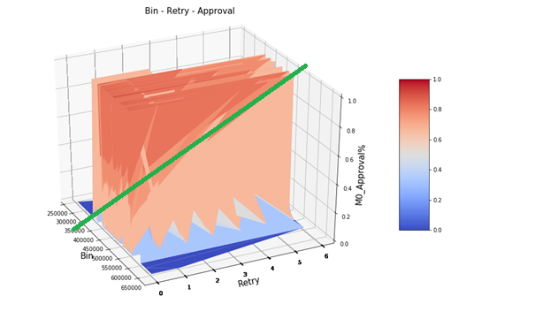
Find a way to separate the “reddest” part!

Slide 9
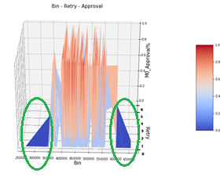
Note
The plot here agree with Arjun’s result. He analyzed the approval% by splitting “bin” into many 2-digit pairs.
He found the same pattern as shown in this grahp.

Slide 10
Classification Method 1 Decision tree
2

Slide 11

When running the decision tree, I set the threshold to be 0.5. Therefore, if a Approval% > 0.5, then it belongs to Class 1. Otherwise, it belongs to Class 0.
You can change to any threshold (between 0 and 1) as you wish by modifying the code in Block 7, threshold = 0.5
The decision tree model used “bin” and “retry_indicator” as feature columns X and “Approval_indicator” as response Y.
I randomly selected 50% of the data as Training Set and 50% of the data as Testing set by the command : X_train, X_test, Y_train, Y_test = train_test_split(X, Y, test_size = 0.5, random_state = None)
Since the Full Decision Tree is too large with many layers and very likely to overfit the data, so I pruned the tree to only 5 layers in order to show it here.
A complex idea can be conveyed with just a single still image, namely making it possible to absorb large amounts of data quickly.

Slide 12

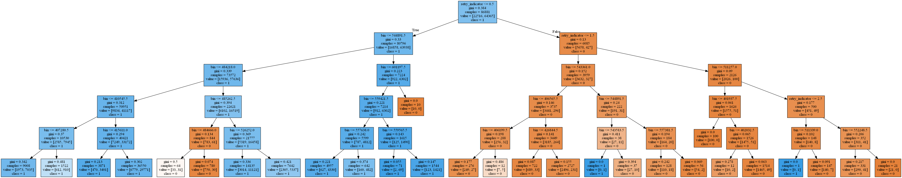
WANT BIG IMPACT?
USE BIG IMAGE.
Blue Box = Class 1 and Orange Box = Class 0
The data is (almost) nicely separated
Let’s Zoom in to the first layer.

Slide 13
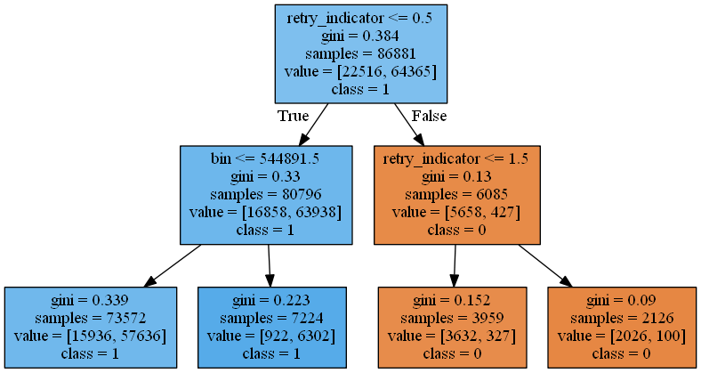
WANT BIG IMPACT?
USE BIG IMAGE.
First Layer of the Plot:

Slide 14
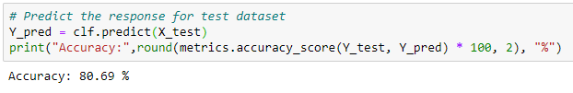
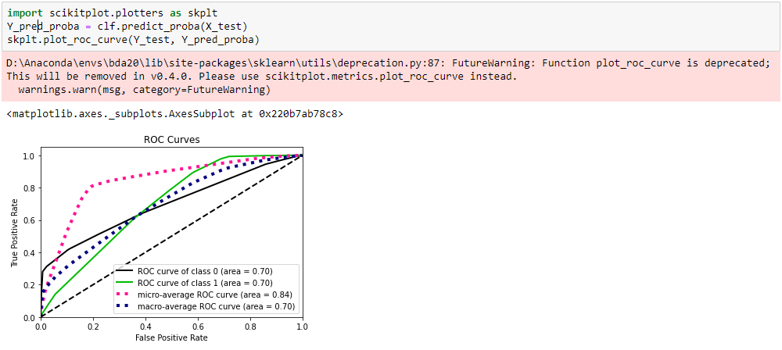
WANT BIG IMPACT?
USE BIG IMAGE.
Accuracy of the 5-layer Pruned Tree:
ROC curve and AUROC

Slide 15
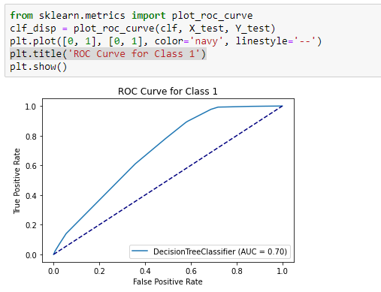
WANT BIG IMPACT?
USE BIG IMAGE.
ROC curve For Class = 1 Only

Slide 16
Conclusion:
A simple decision tree with 5 layers can achieve about 81% accuracy..
Next, lets try to find a even better model.

Slide 17
WANT BIG IMPACT?
USE BIG IMAGE.
By Bias-Variance trade off, we know that if a model is overfitting the data, it is more likely to get a high accuracy on training set, but low accuracy on testing set.
As shown in previous page, I only did a 5-layer Decision Tree in order to make it simpler to understand, but it is possible that a tree with more layers will achieve even higher accuracy.
Here I looped through trees with 1 to 100 layers, and I calculated the accuracy for each tree. Finally, I output the one with the most accurate one and plot a graph to prevent overfitting.

Slide 18
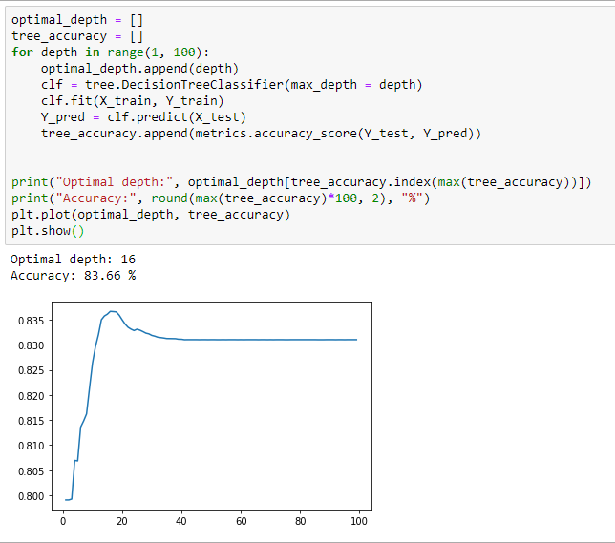
WANT BIG IMPACT?
USE BIG IMAGE.
The testing data accuracy is decreasing in this region => overfitting

Slide 19
Comment:
I implemented the Decision Tree plot using sklearn python package, with default criteria “Gini-Index”. Other options like “entropy” also work by changing:
clf = tree.DecisionTreeClassifier(criterion="entropy", max_depth = depth)

Slide 20
Classification Method 2 Random Forest
3

Slide 21
Note:
Since the dataset is huge, my computer can only implement a very simple random forest algorithm and it takes about 5 mins to complete.
My plan is trying to complete a larger random forest model with options like boosting, bagging on Google Colab in the future.

Slide 22
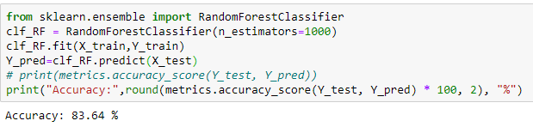
WANT BIG IMPACT?
USE BIG IMAGE.
Here is the code I used to create a random forest with only 1000 trees
Since it’s already a pretty large model, so I did not plot the random forest.
We can see that with Random Forest model, we can achieve 83.6% accuracy.

Slide 23
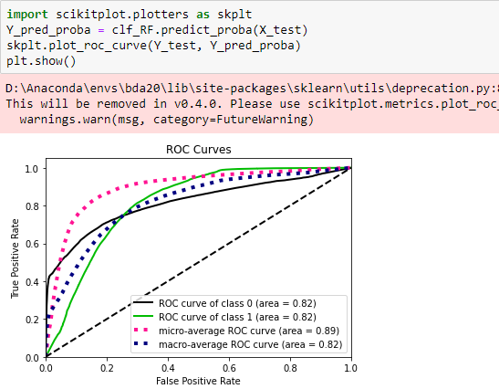
WANT BIG IMPACT?
USE BIG IMAGE.
ROC curve and AUROC

Slide 24
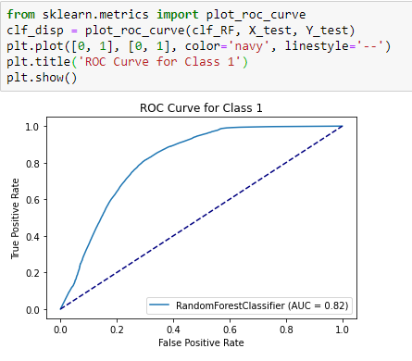
WANT BIG IMPACT?
USE BIG IMAGE.
ROC curve For Class = 1

Slide 25
Conclusion:
By Random Forest, we can achieve a better accuracy 83.65 %.
However, since Random Forest is a much complicated model compared with Decision Tree, and the accuracy does NOT increase by a large amount, so I think a normal Decision Trees will be better for real-life implementation.

